Slide 1
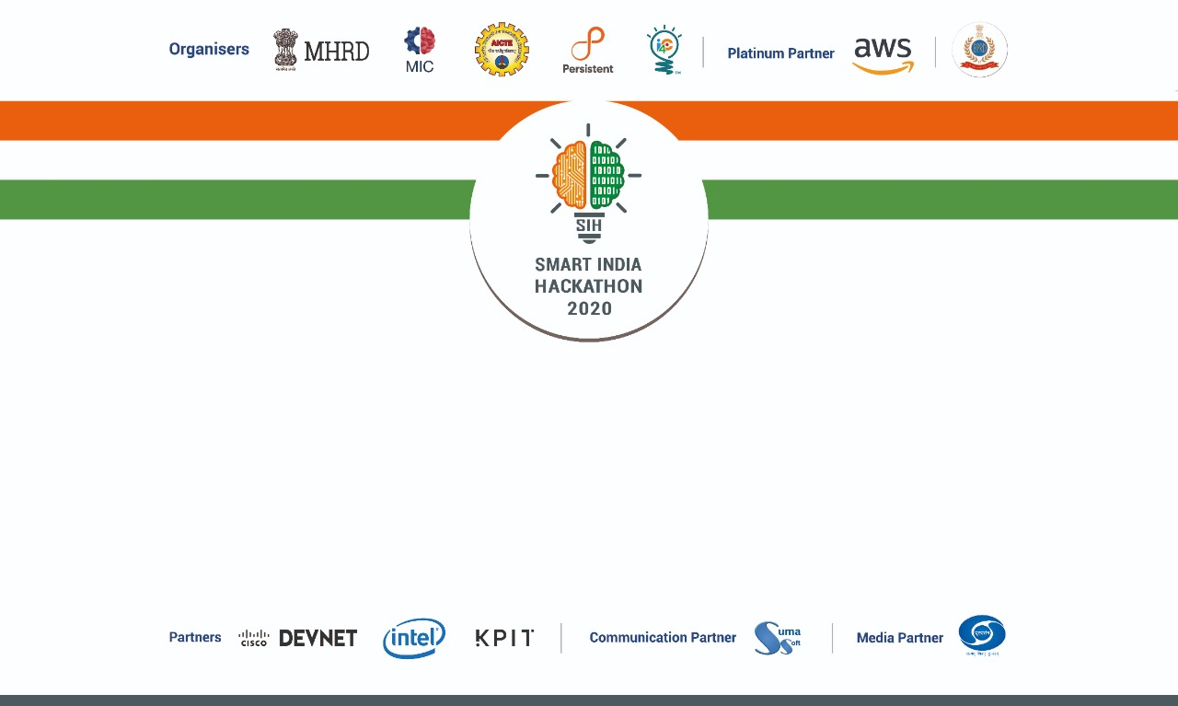
TEAM NAME: CODE_CRUNCH
PROBLEM STATEMENT CODE: MK95
MINISTRY NAME: GOVERNMENT OF UTTARAKHAND
TEAM MENTOR NAME: PROF. AJU PALLERI
TEAM LEADER NAME: MAHESH MAHAJAN
TEAM MEMBERS:
NEHA PATIL
PRANALI SAWANT
PREETAM B.A
LOVKESH SHARMA
KARAN NAIR

Slide 2
Problem Statement
National Web Portal is used for designing Job oriented courses with the help of Human Resource data and desirable skill sets from industries. Design a system to read the job description from the pdf and word document provided by government officials. Provide facility to review and edit the generated job description and publish on the portal. This portal should also provide facility to apply for job and further management of interview and selection process.

Slide 3
Introduction
A web based job portal RecruitUttarakhand.in designed using flask framework consist of 3 parts- user, employer and interview system.
Hosts all the vacancies posted by different organizations.
Applications for jobs posted in different government/private sectors.
Providing a platform for interview and selection processes.
Table Detection using camelot library and extracting table and text using camelot from pdf/doc followed by auto-filling of the same in the input section while posting a job.
Maintaining a profile for User and Employer.
Up-to-date notification system for user.

Slide 4
Features
One stop solution for complete job hiring process.
Smart application tracking system.
Job search filter according to the user’s requirement.
Integrated online adaptive testing platform.
User friendly and developer friendly web application.
Reduces human time and effort.
Robust and light-weight technology stack.

Slide 5
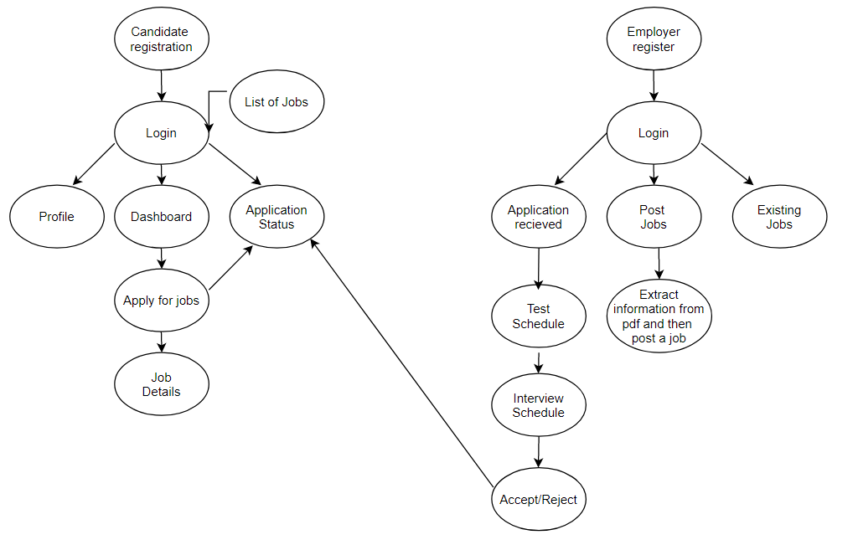
Flow of the application:

Slide 6
Task Completed
Registration and Login functionalities for both User and Employer.
Profile is maintained for Editing, Deleting, Adding, and Updating details.
Application Tracking System (Status: Applied, test pending, test completed, interview scheduled, interview completed, accept or reject application).
Job search filter according to part time, minimum salary/pay, location and company wise.
Extraction of table (using camelot)and text from the Pdf followed by auto-filling of the form.
Online Adaptive Assessment Platform.
Interview Management System.
Statistics of (jobs, candidates hired, application received etc) on dashboard.
Uploading Profile Picture.
Complete application tracking system implemented.
Recommendation of jobs according to the candidate skills.
Up-to-date notification system.
Multilingual support.

Slide 7
Technology Stack
Frontend: Flask, Bootstrap, HTML, CSS, JavaScript
Backend: jQuery, Python.
Database: MySQL
Technique: NLP ( camelot)

Slide 8
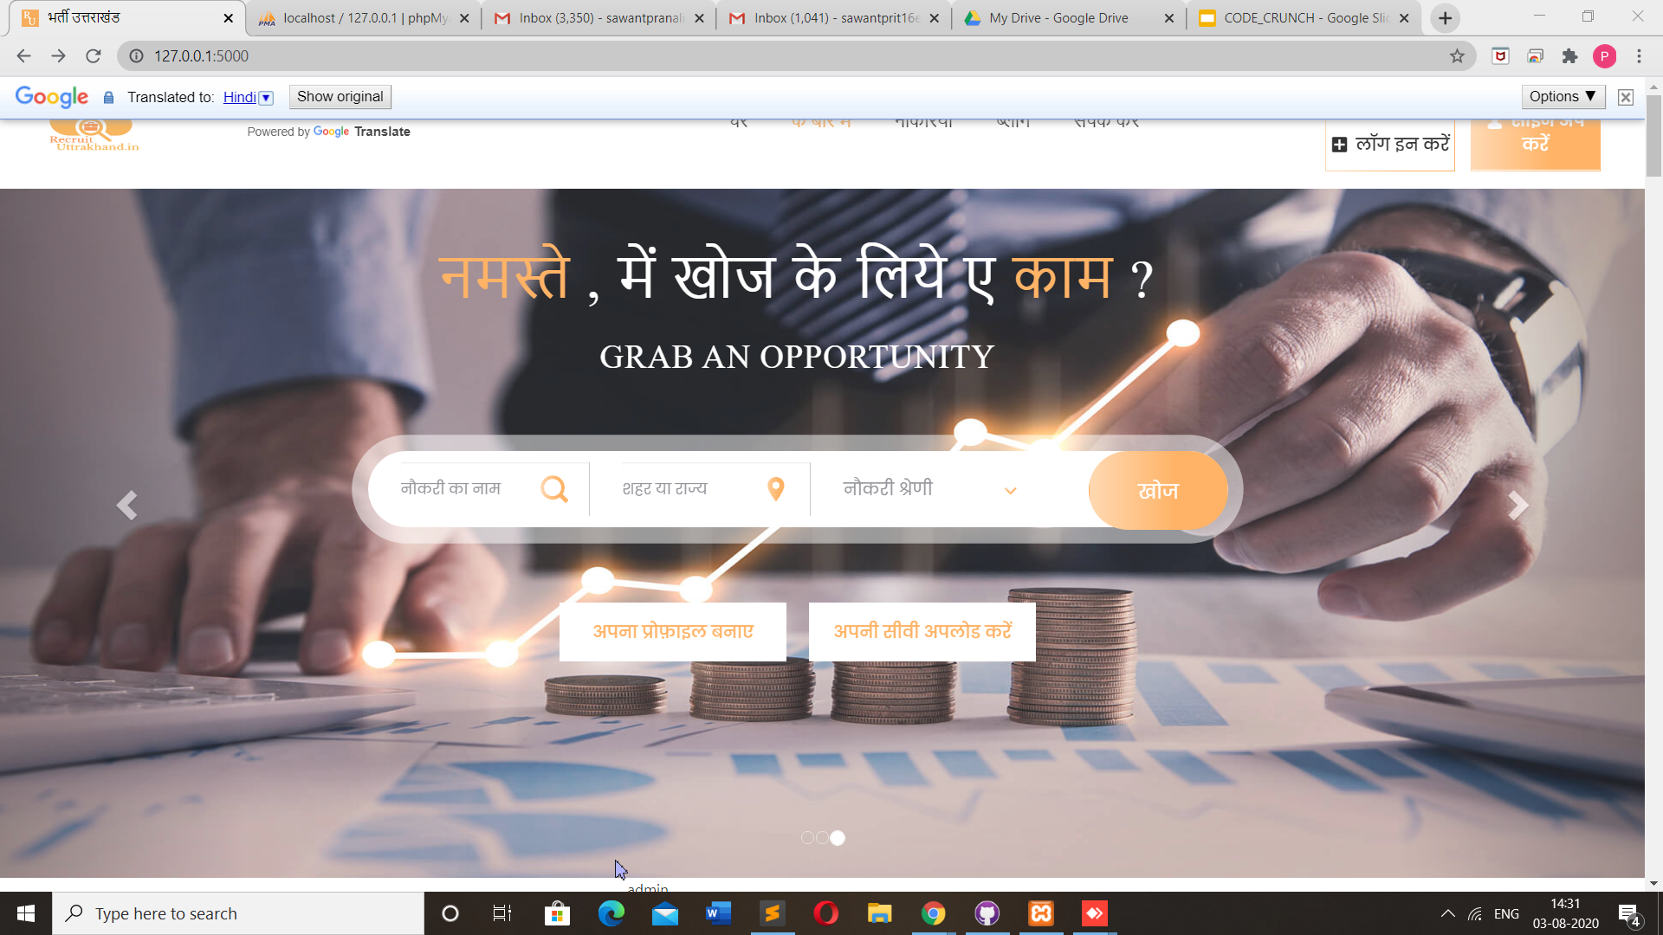
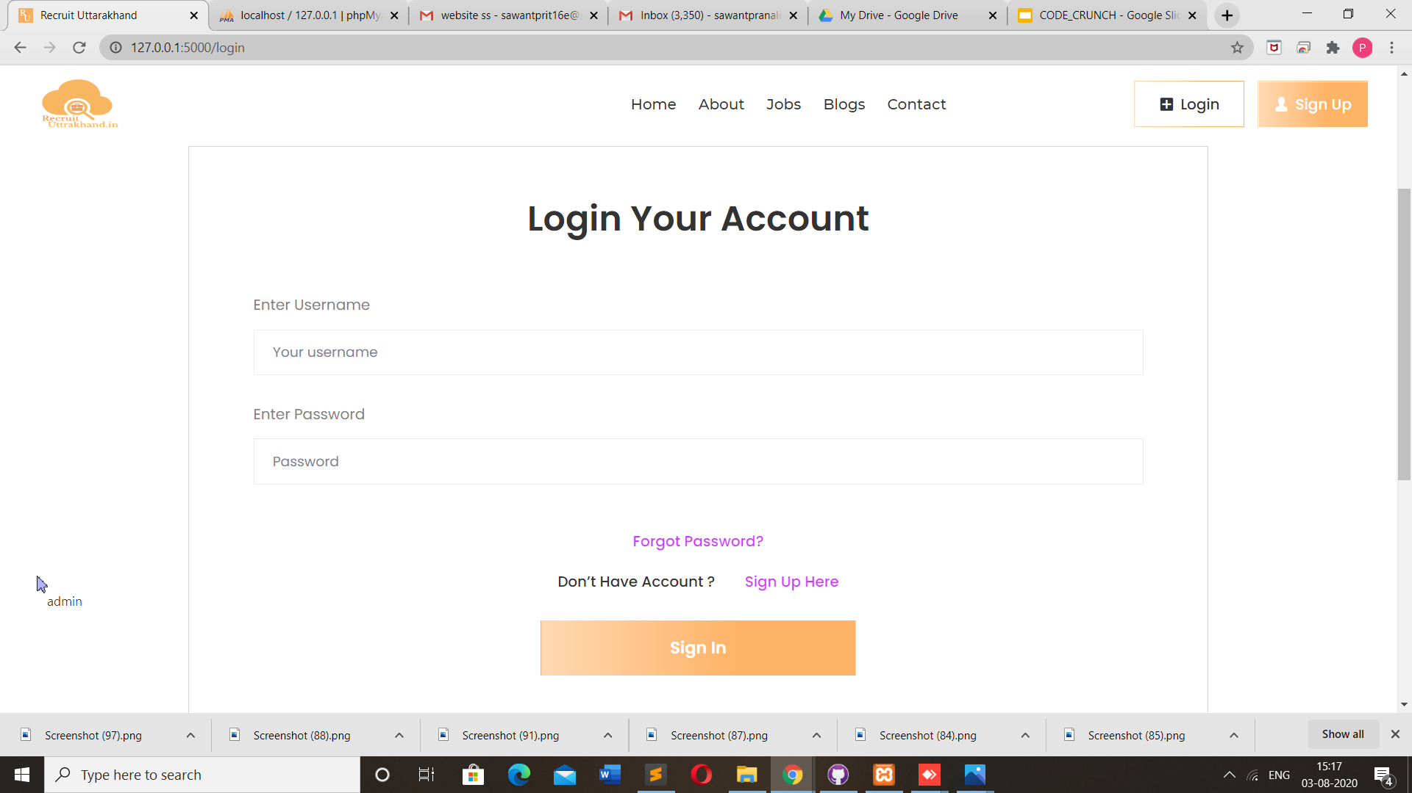
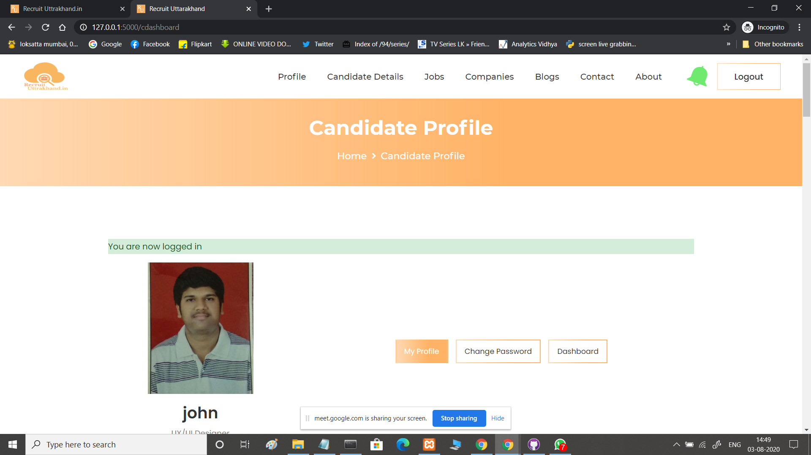
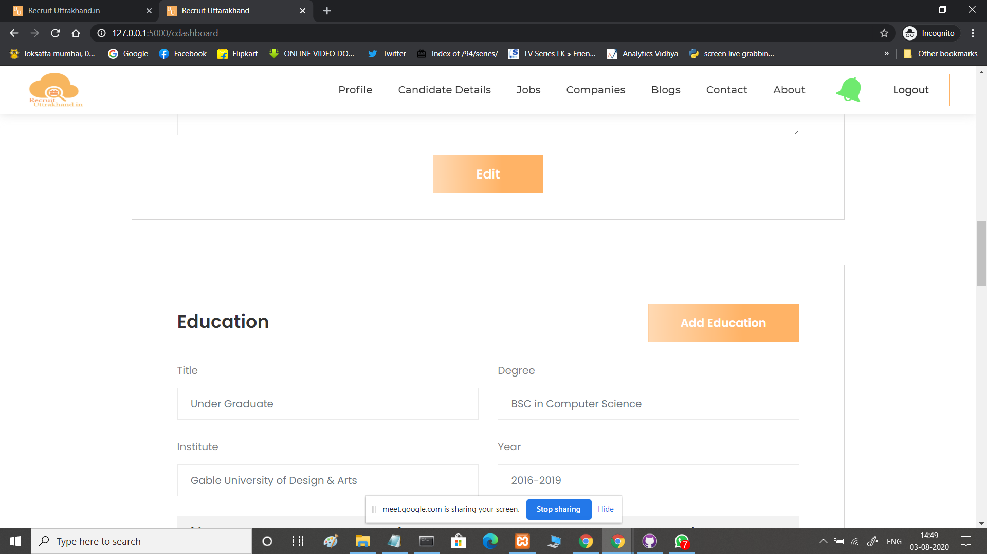
Screenshots
HOMEPAGE
LOGIN PAGE
PROFILE EDITING PAGE
PROFILE PAGE

Slide 9
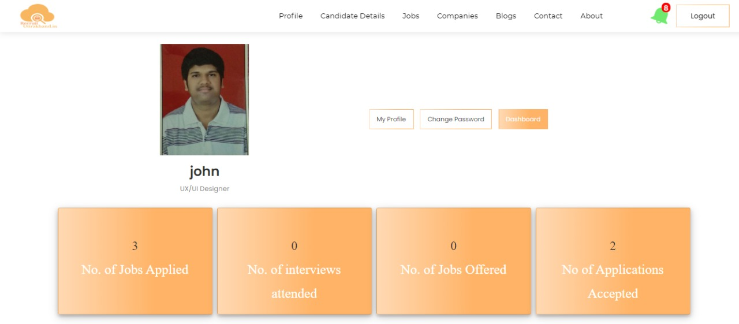
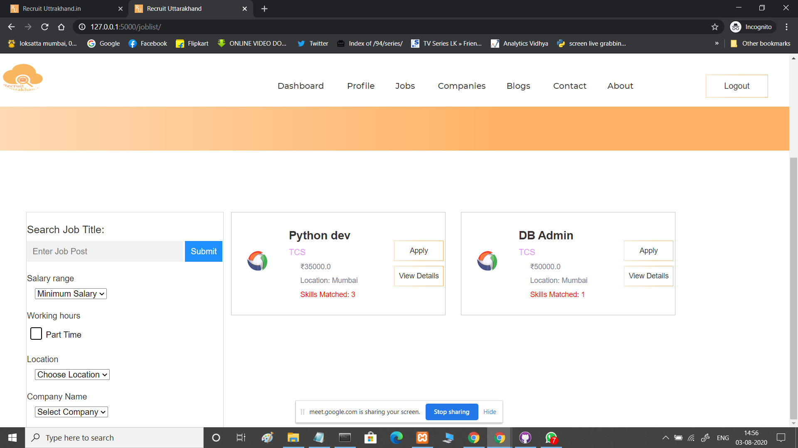
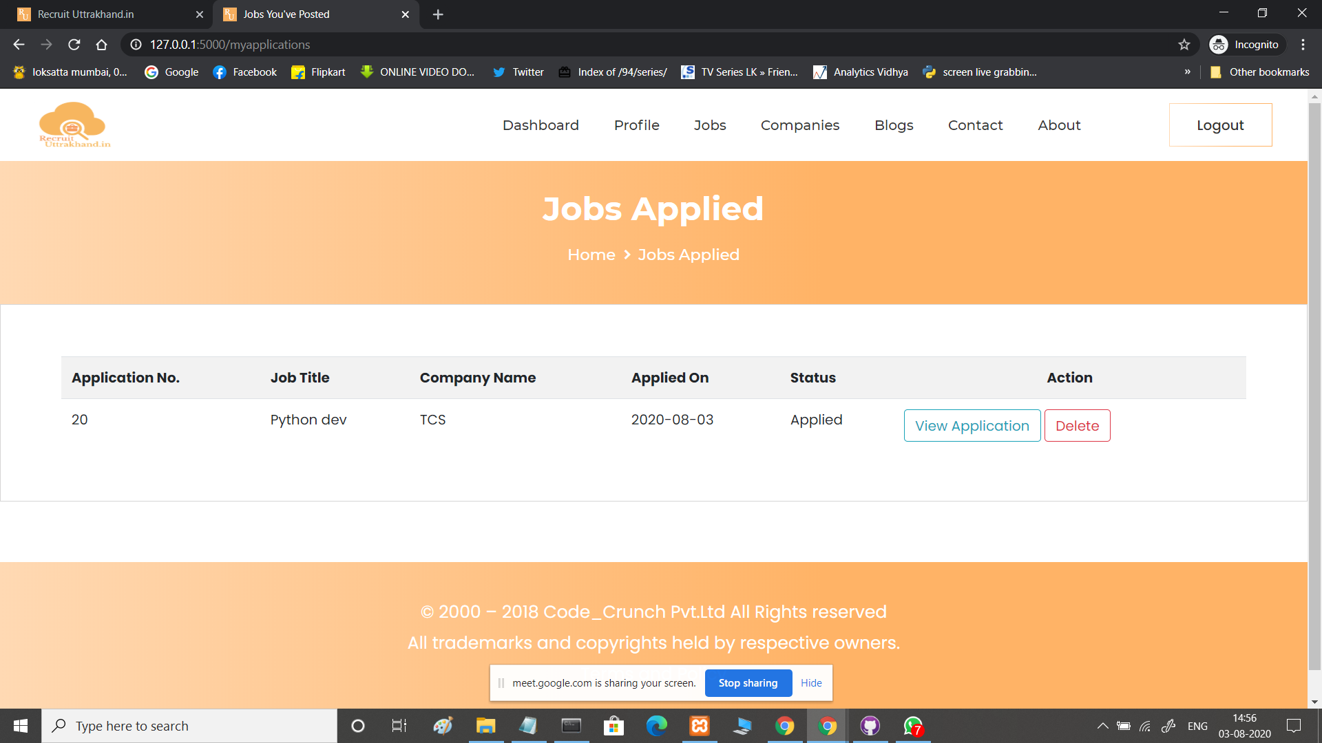
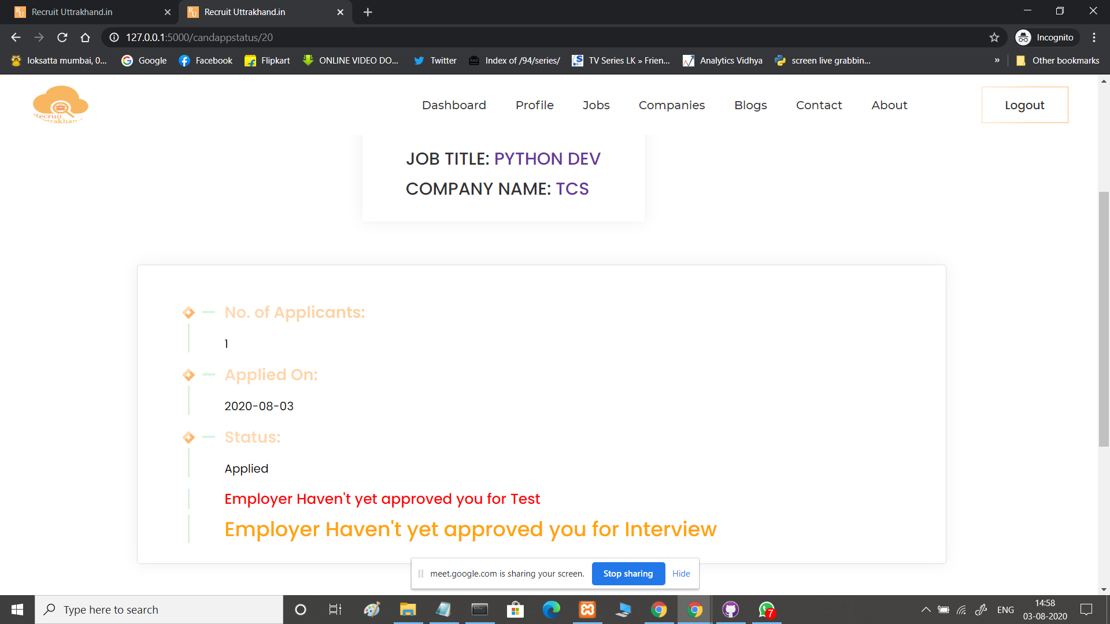
Screenshots
STATISTICS
JOB LISTS
APPLIED JOB
CANDIDATE APPLICATION STATUS

Slide 10
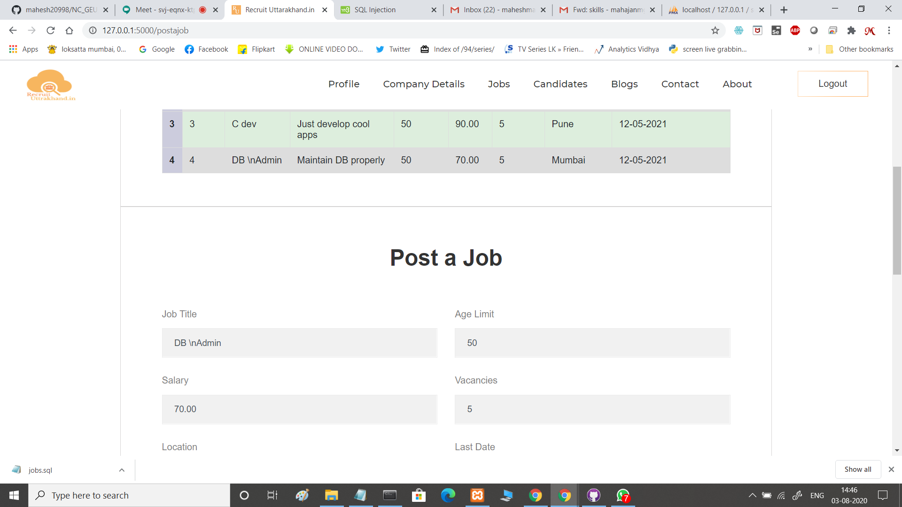
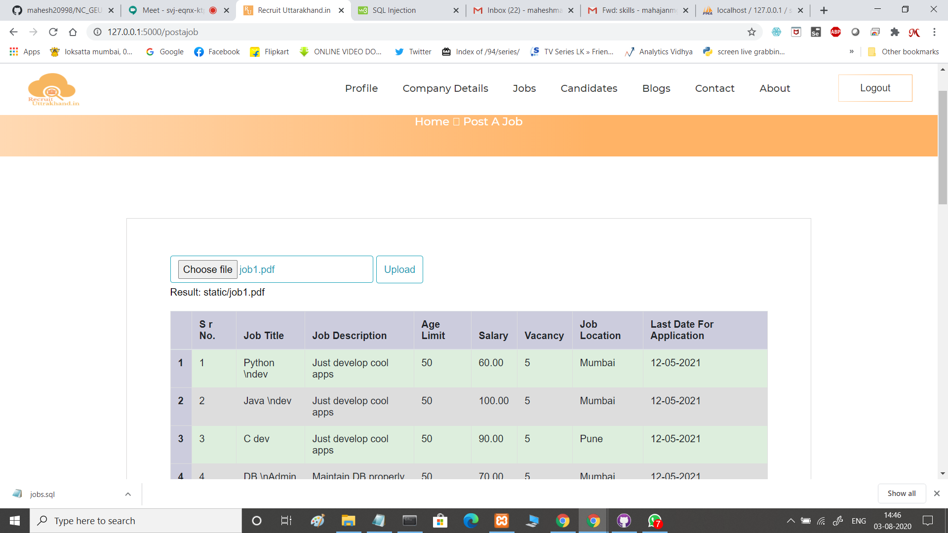
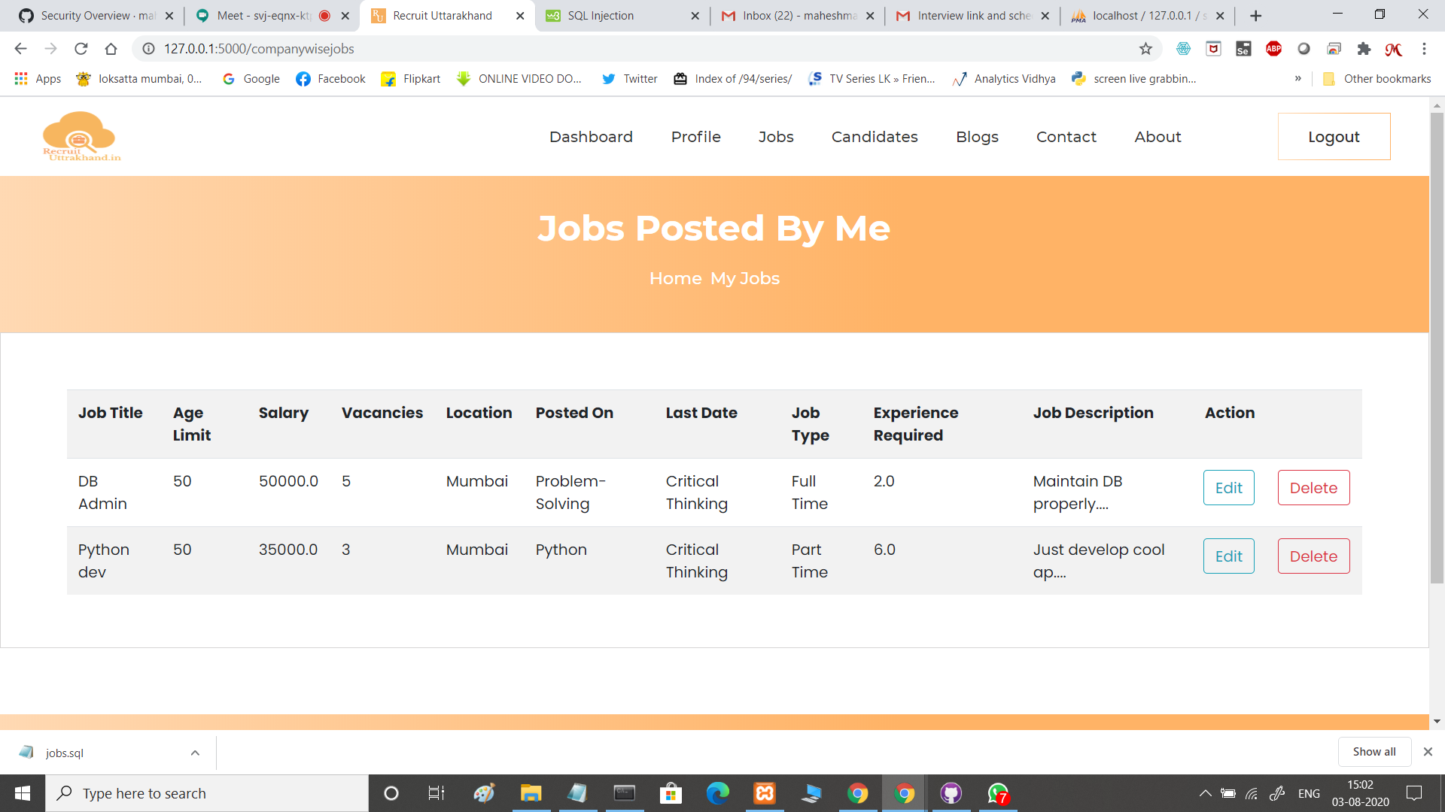
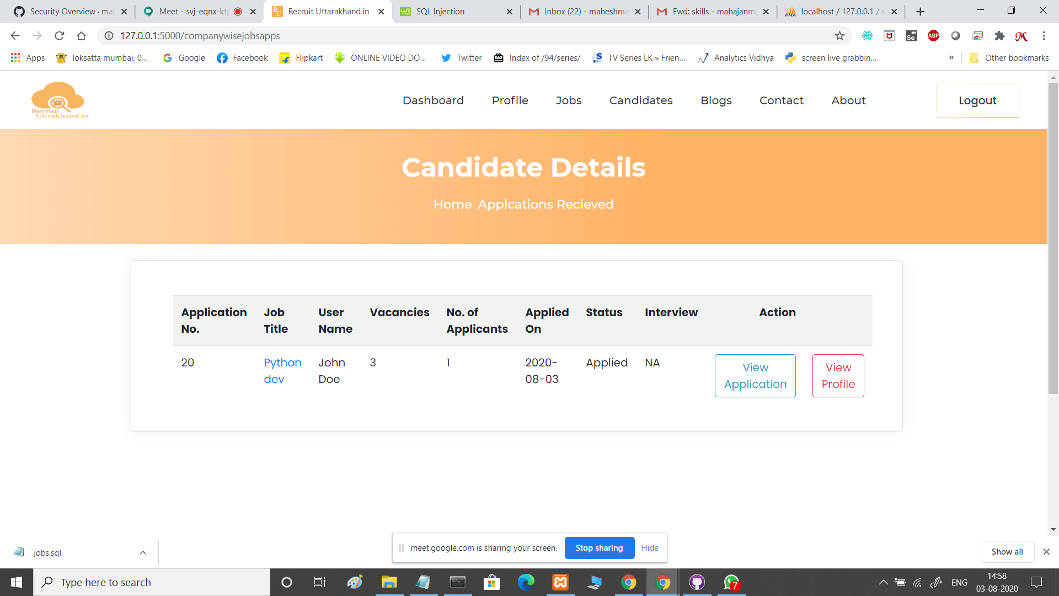
Screenshots
PDF EXTRACTION
POSTING A JOB
POSTED JOBS
CANDIDATE DETAILS

Slide 11
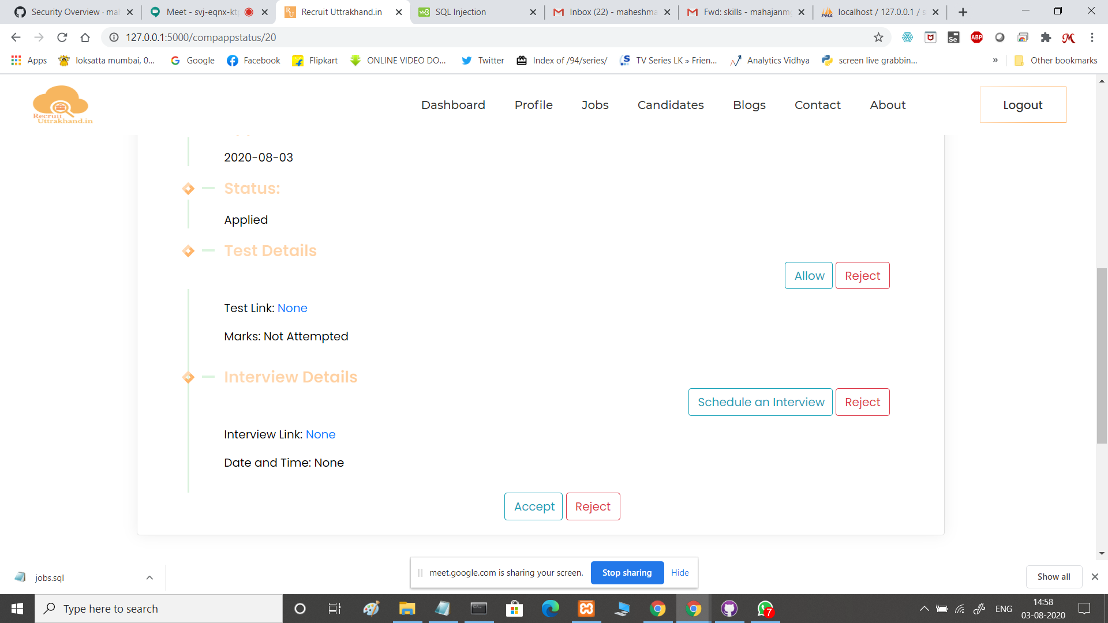
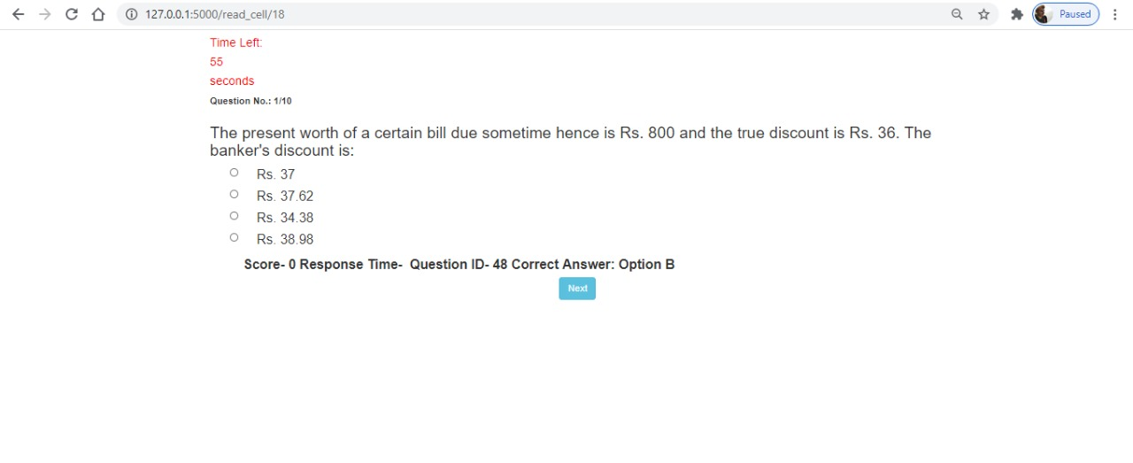
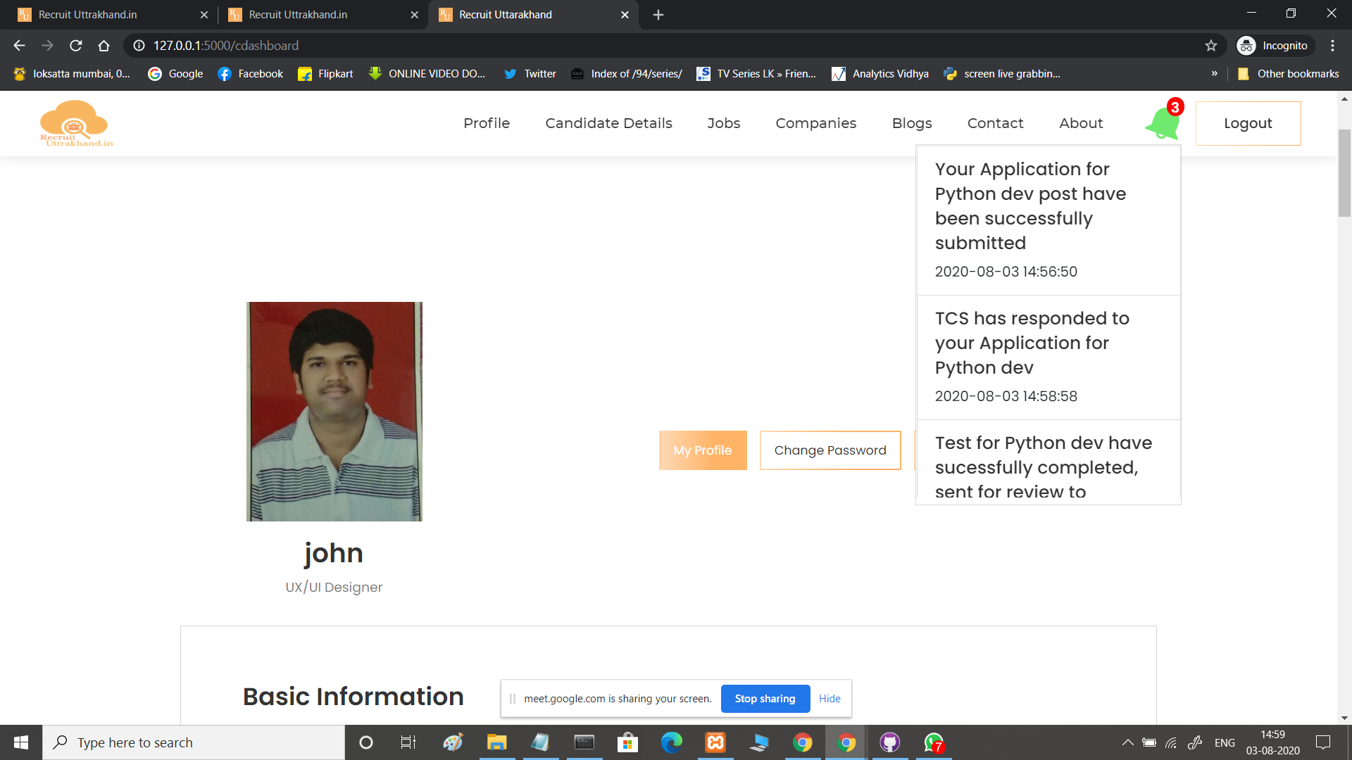
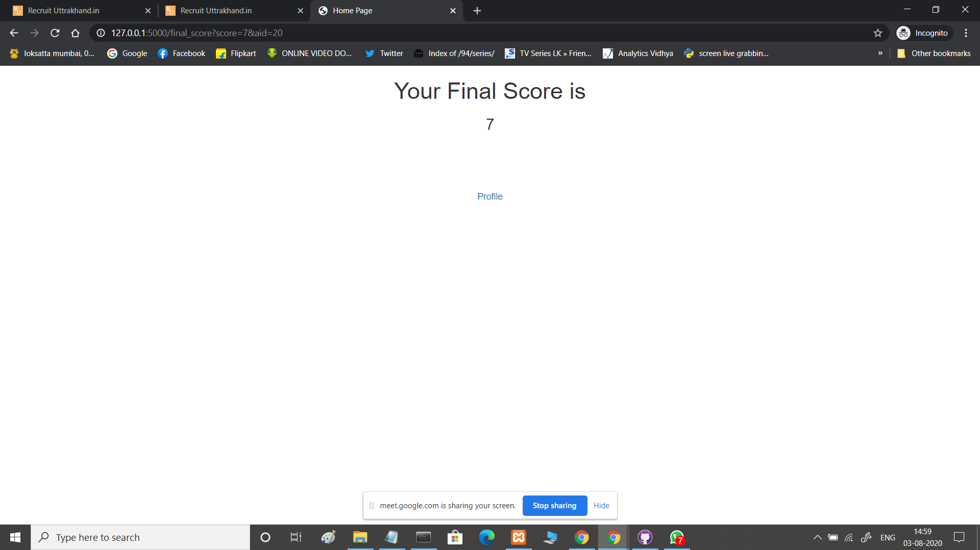
Screenshots
TEST QUESTION PAGE
COMPANY APPLICATION STATUS
TEST COMPLETION PAGE
UP-TO-DATE NOTIFICATION

Slide 12
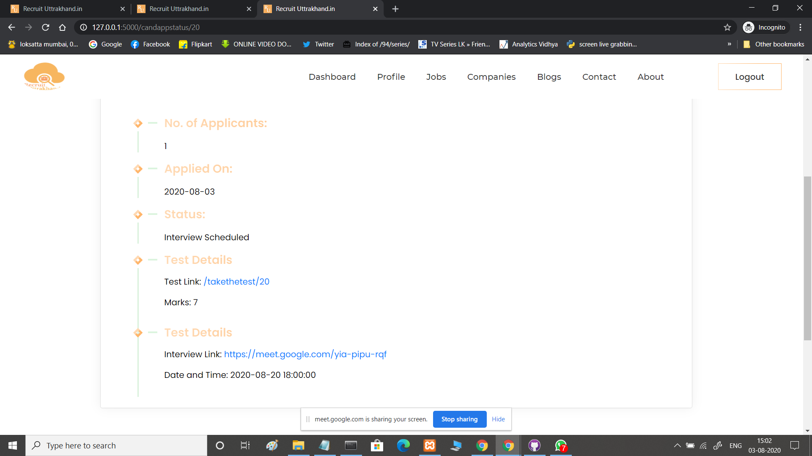
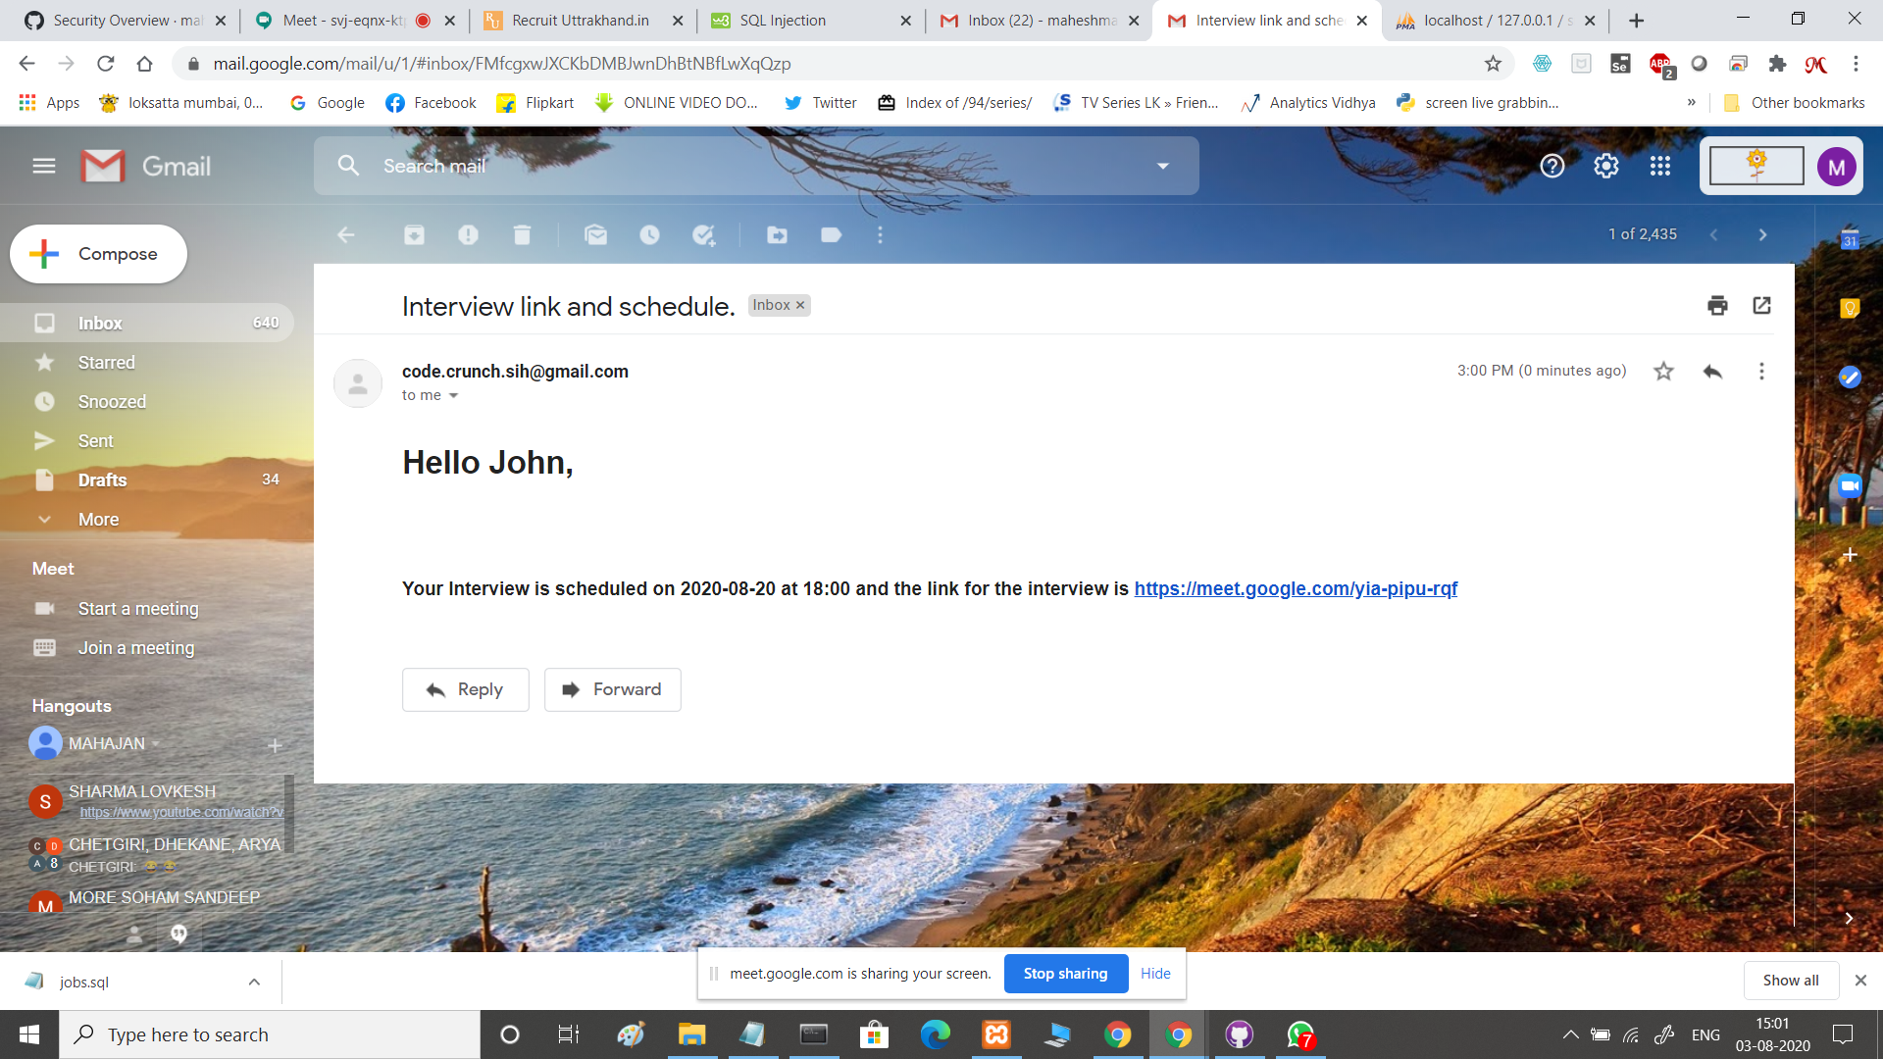
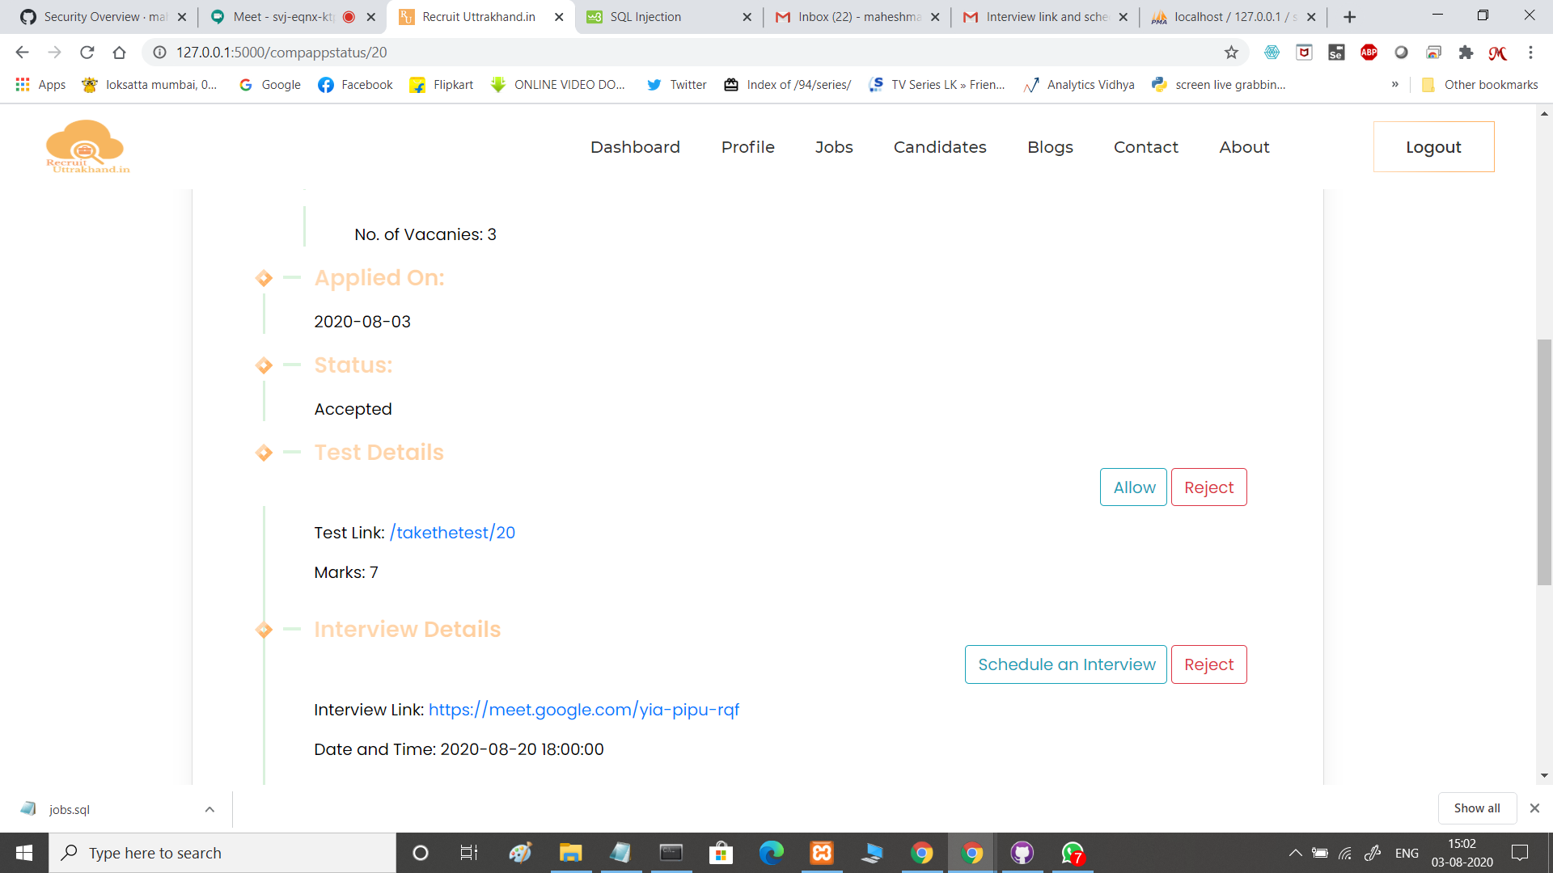
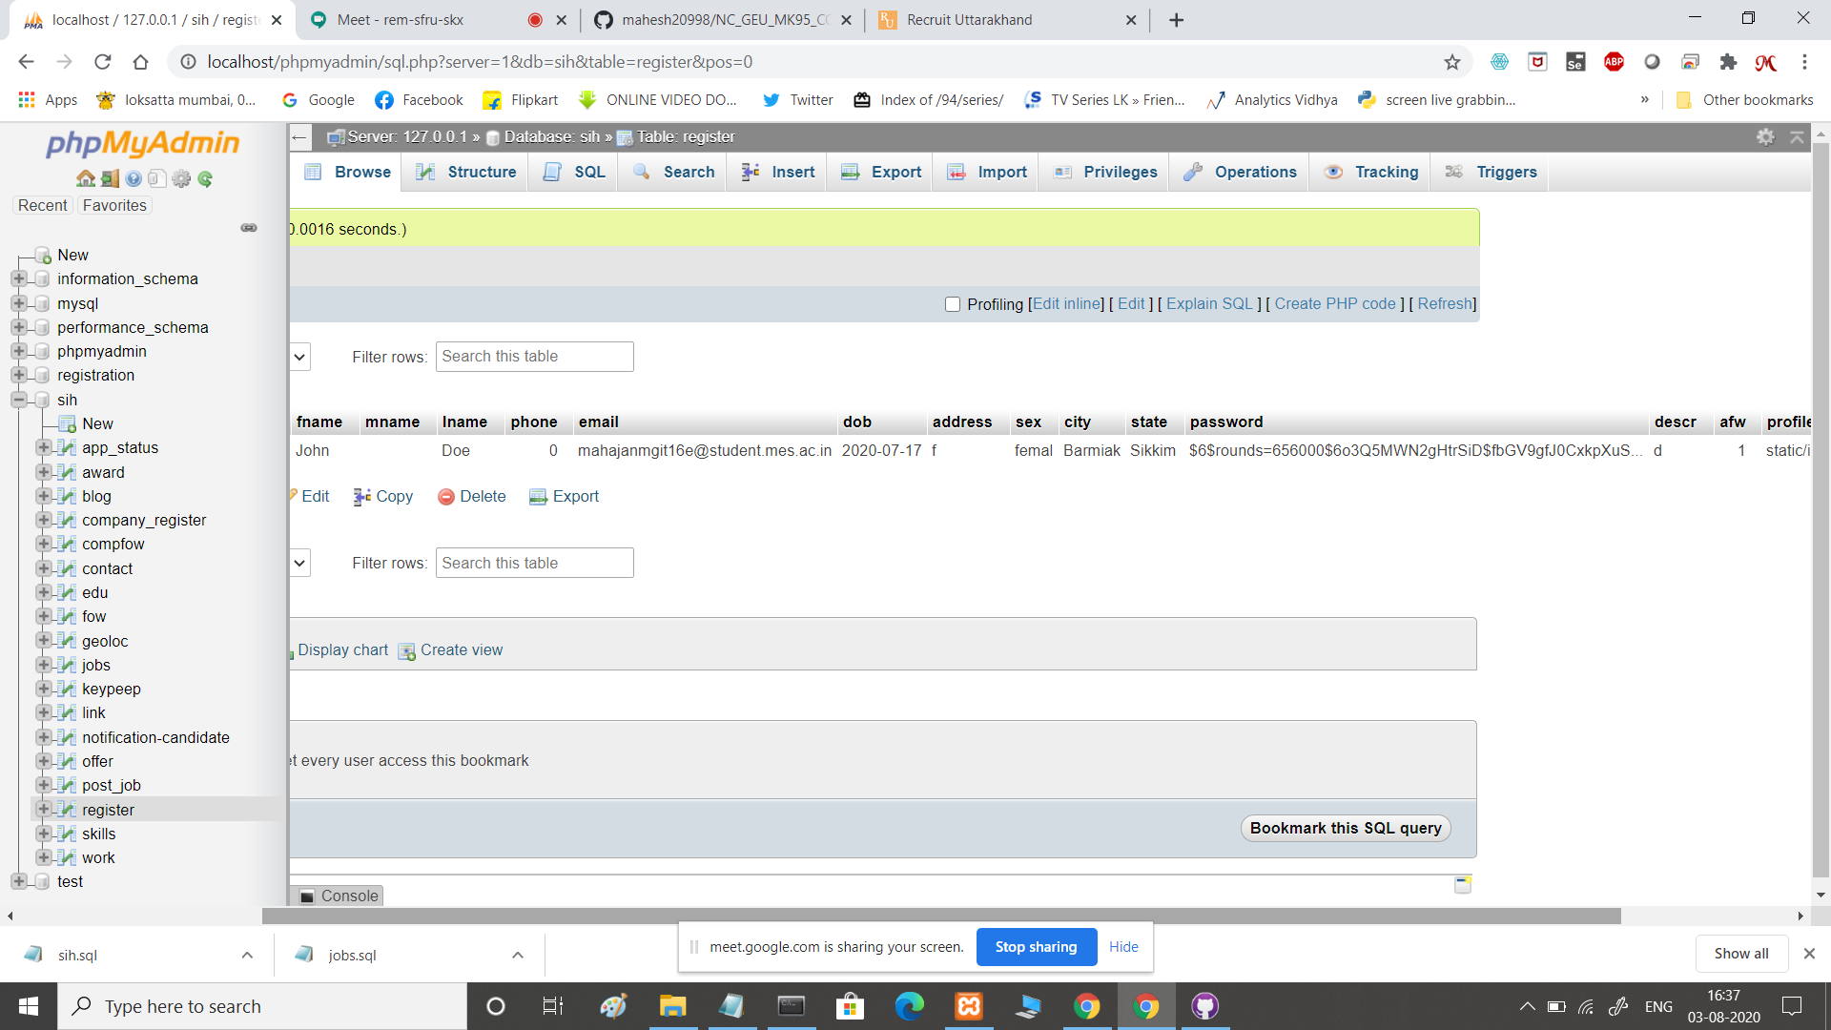
Screenshots
INTERVIEW SCHEDULE
INTERVIEW MEET LINK
APPLICATION ACCEPTED
PASSWORD ENCRYPTION

Slide 13
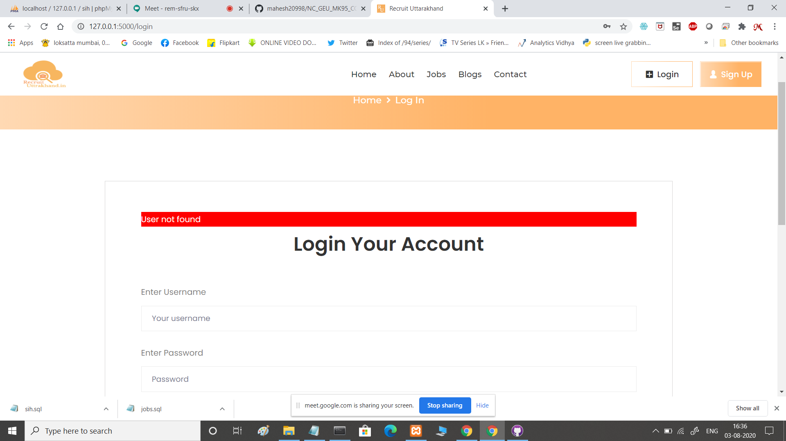
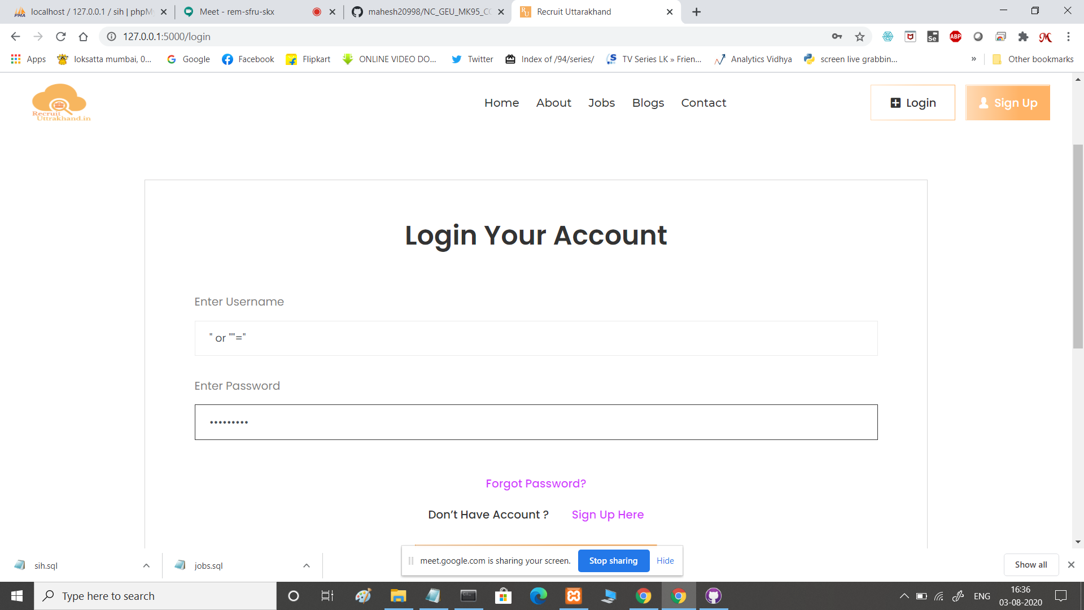
Screenshots
SQL INJECTION
TRYING SQL INJECTION

